Slide 1
Integrated Learning Management System (ILMS)
Project VERT ILMS

Slide 2
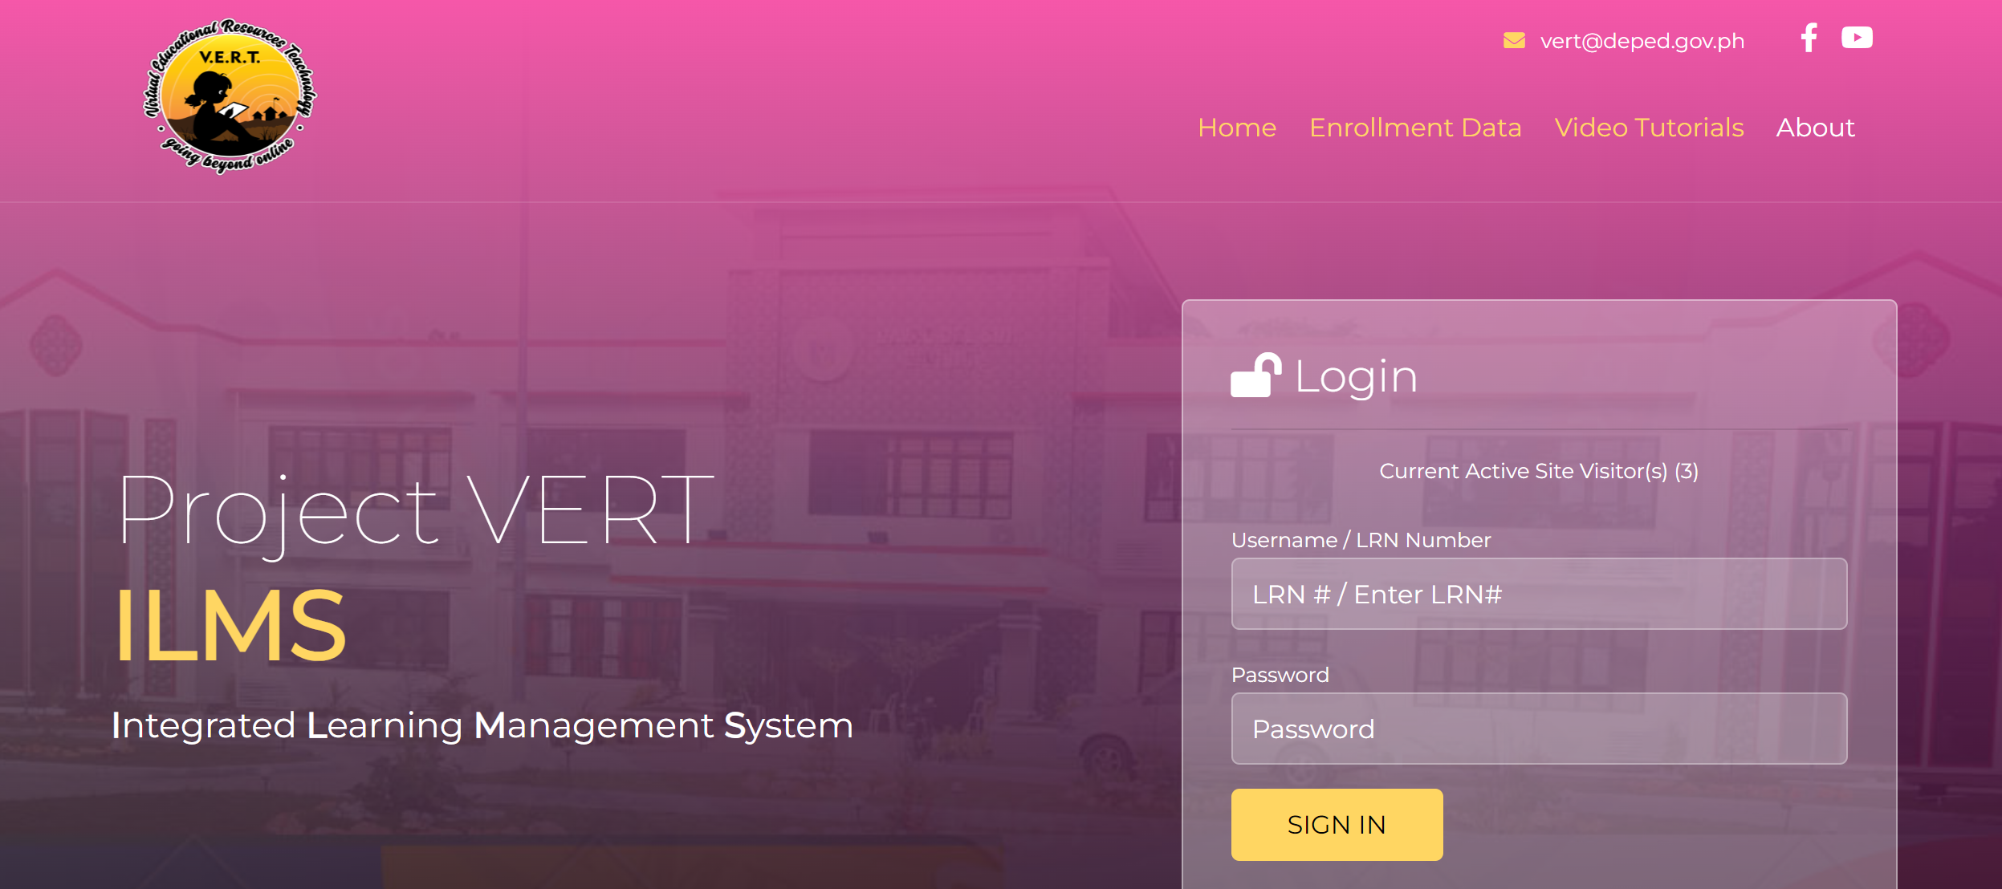
LOGIN PAGE
ILMS

Slide 3
ADMIN ACCOUNT

Slide 4
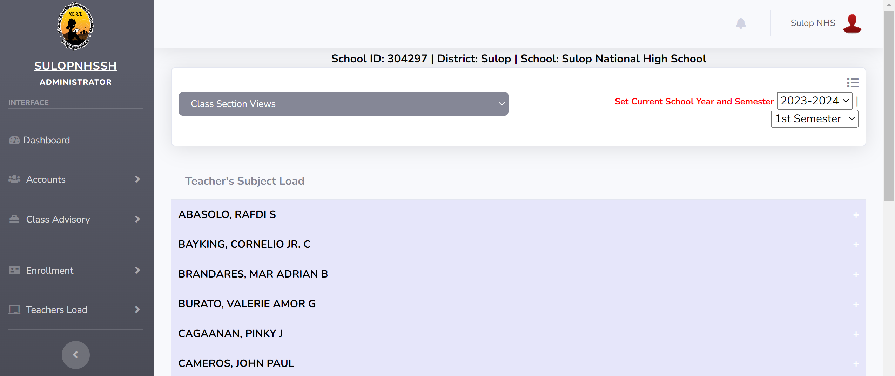
ADMIN DASHBOARD PAGE
ILMS
ADMIN ACCOUNT

Slide 5
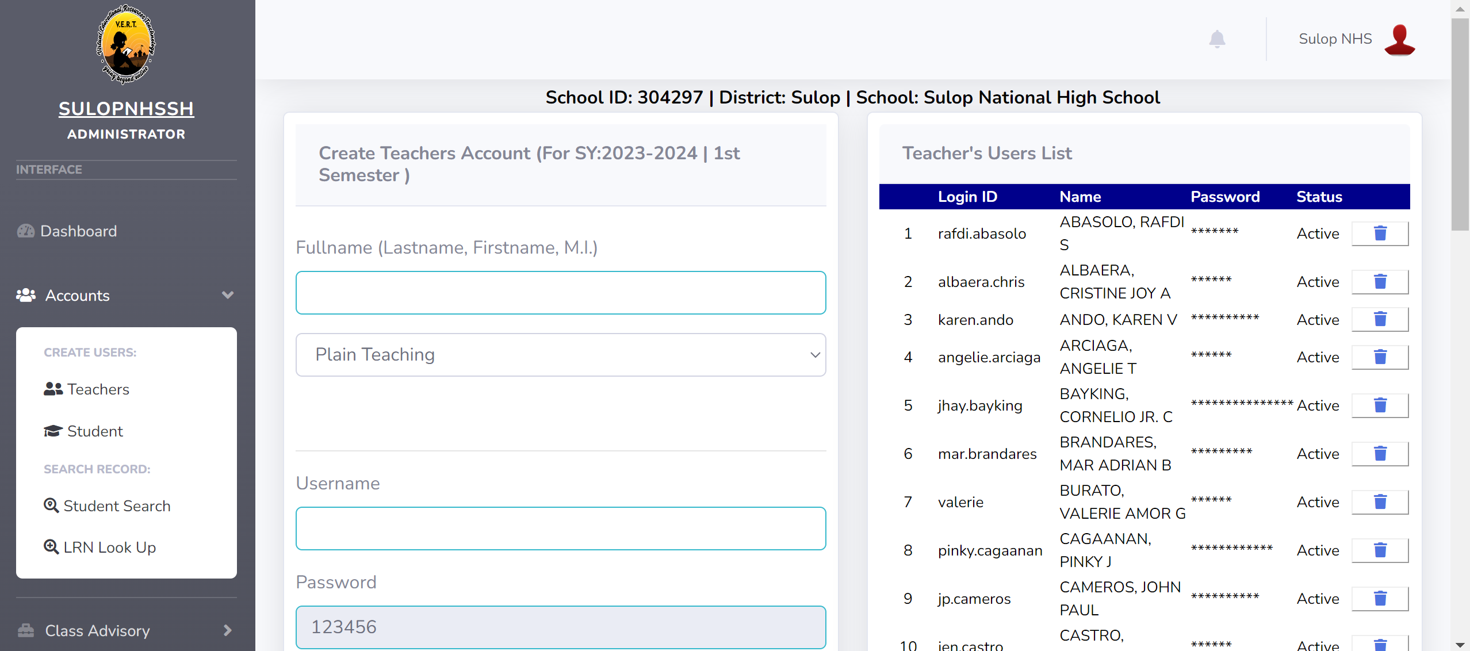
CREATING TEACHER’S ACCOUNT
ILMS
ADMIN ACCOUNT
Notes:
Click <account> select <Teacher> for creating or adding teacher’s account

Slide 6
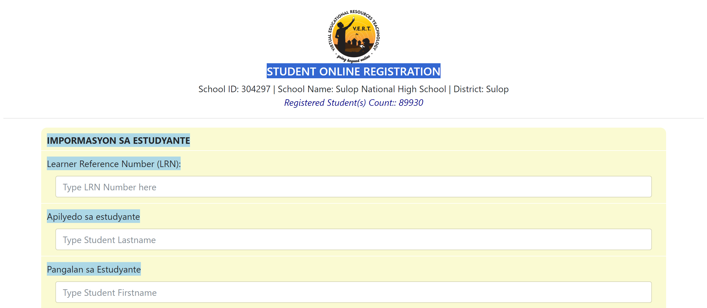
STUDENT ONLINE REGISTRATION
ILMS
ADMIN ACCOUNT
Notes:
Click <account> select <Student> for adding students not yet registered in the system of the specific school

Slide 7
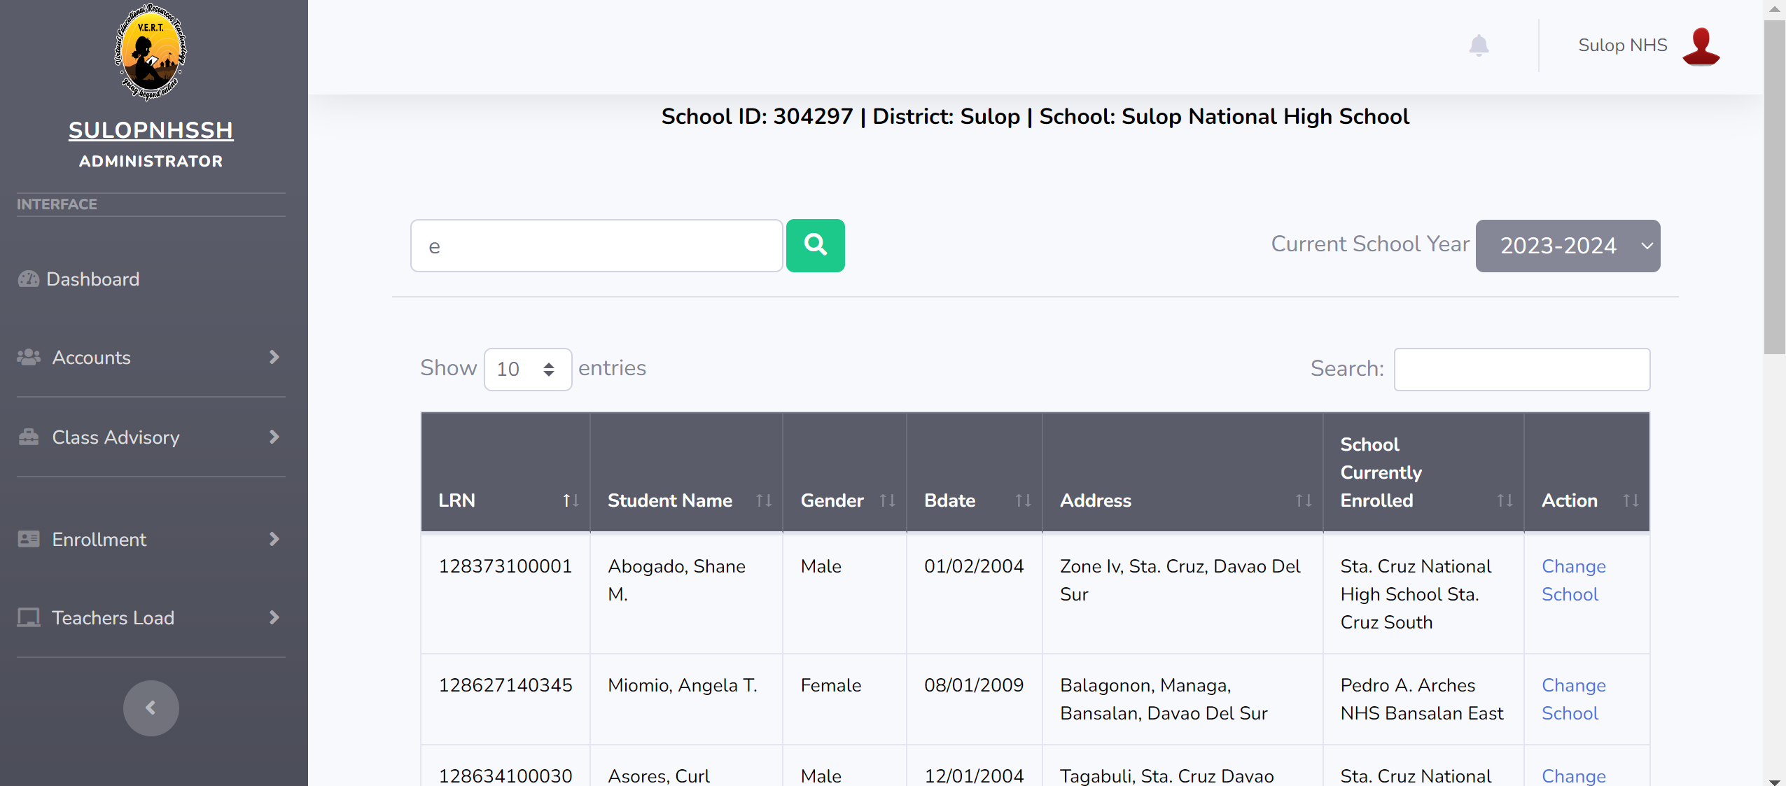
ADDING STUDENT ENROLLED FROM OTHER SCHOOL
ILMS
JUAN
12345678901 | JUAN DELA CRUZ | Male | 01/01/2001 | Poblacion Sta. Cruz
ADMIN ACCOUNT
Notes:
Click <account> select <Student Search> type name of student / click <Change School> for adding student enrolled from other school

Slide 8
LRN LOOKUP
ILMS
JUAN
12345678901 | JUAN DELA CRUZ | Male | 01/01/2001 | Poblacion Sta. Cruz
ADMIN ACCOUNT
Notes:
Click <account> select <Student Search> type name of student / click <Change School> for adding student enrolled from other school

Slide 9
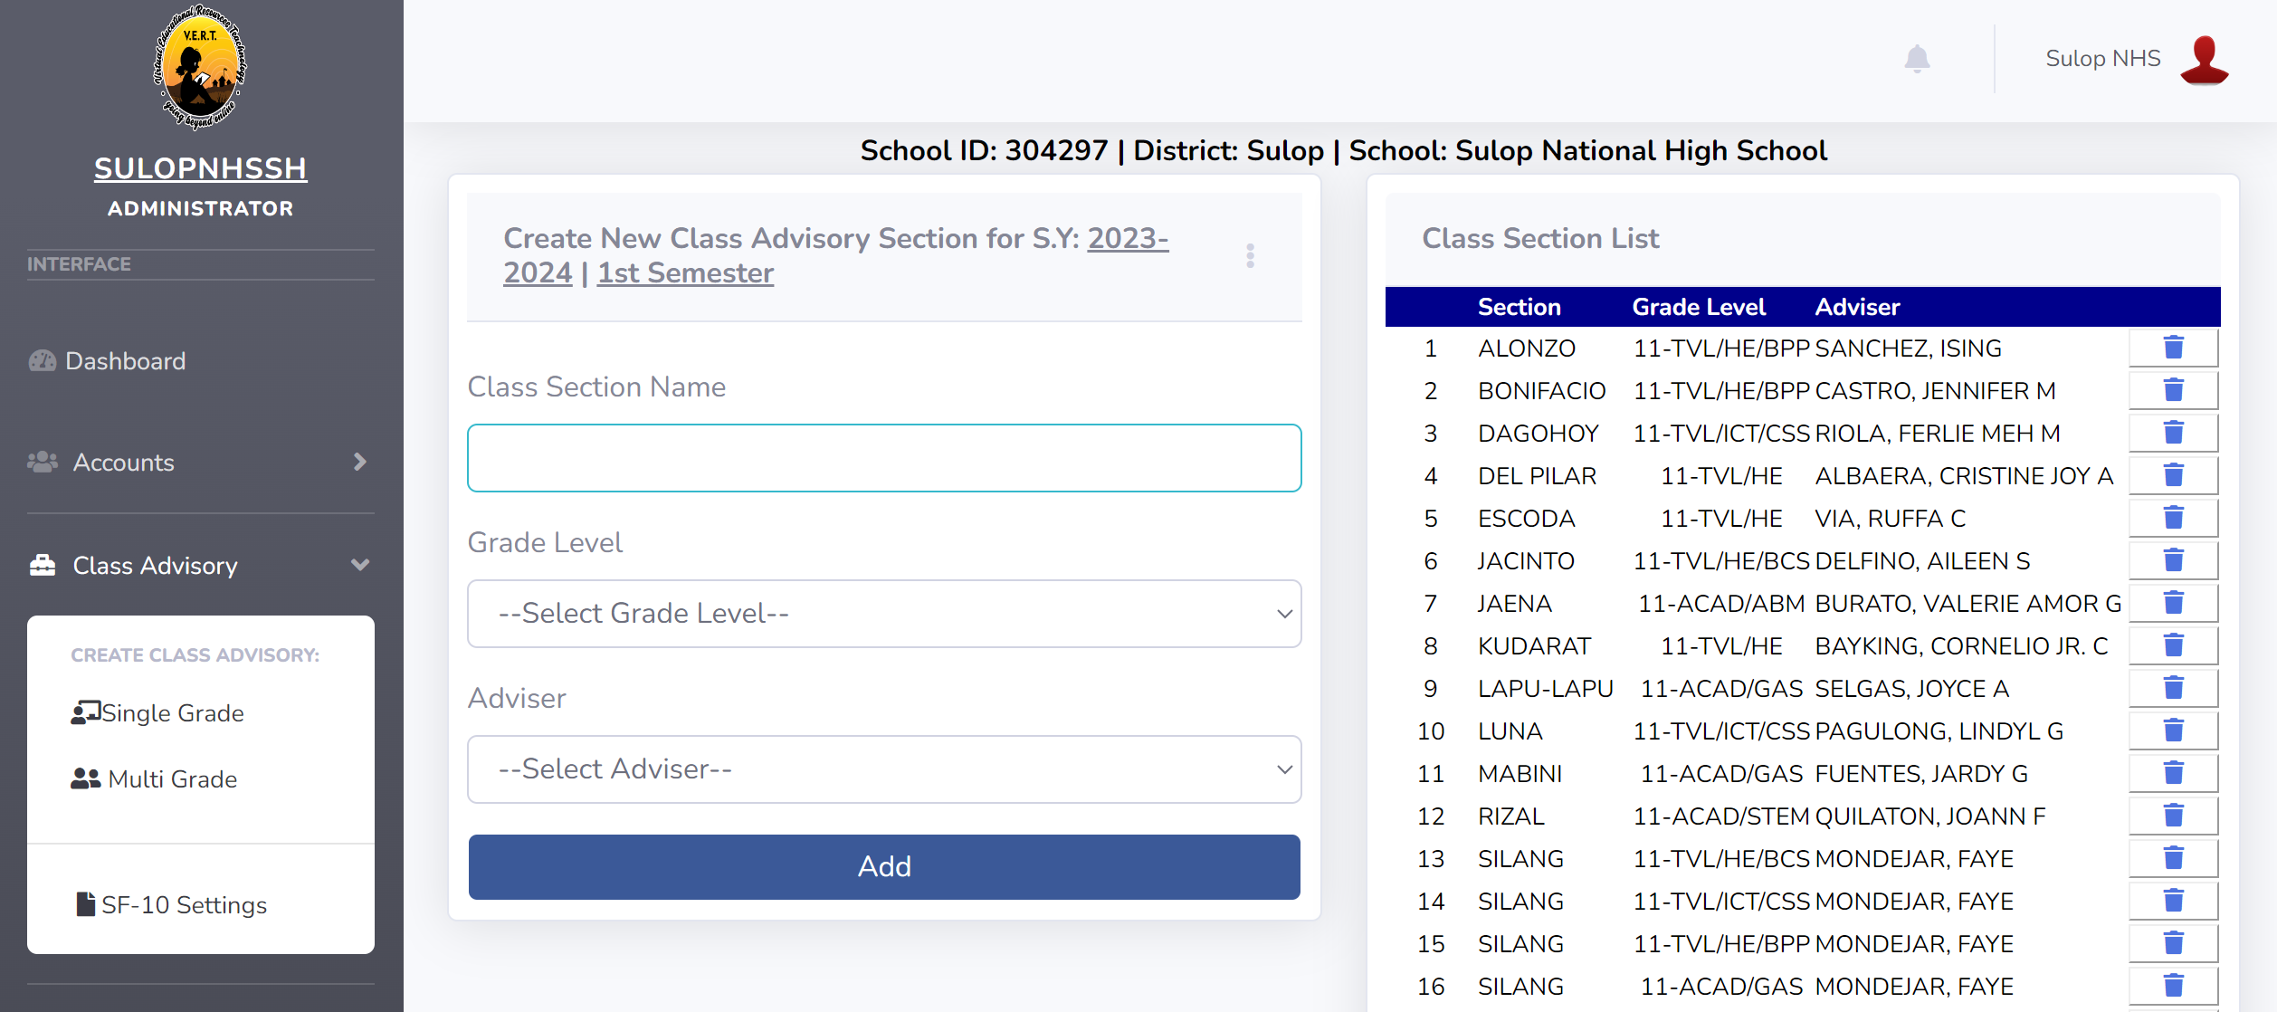
ASSIGNING CLASS SECTION/ADVISORY
ILMS
JUAN
ADMIN ACCOUNT
Notes:
Click <Class Advisory> select <Single or Multi Grade> to add/create class advisory. Single Grade for 1 teacher = 1 advisory; Multi Grade for 1 teacher = 2 or more advisory.

Slide 10
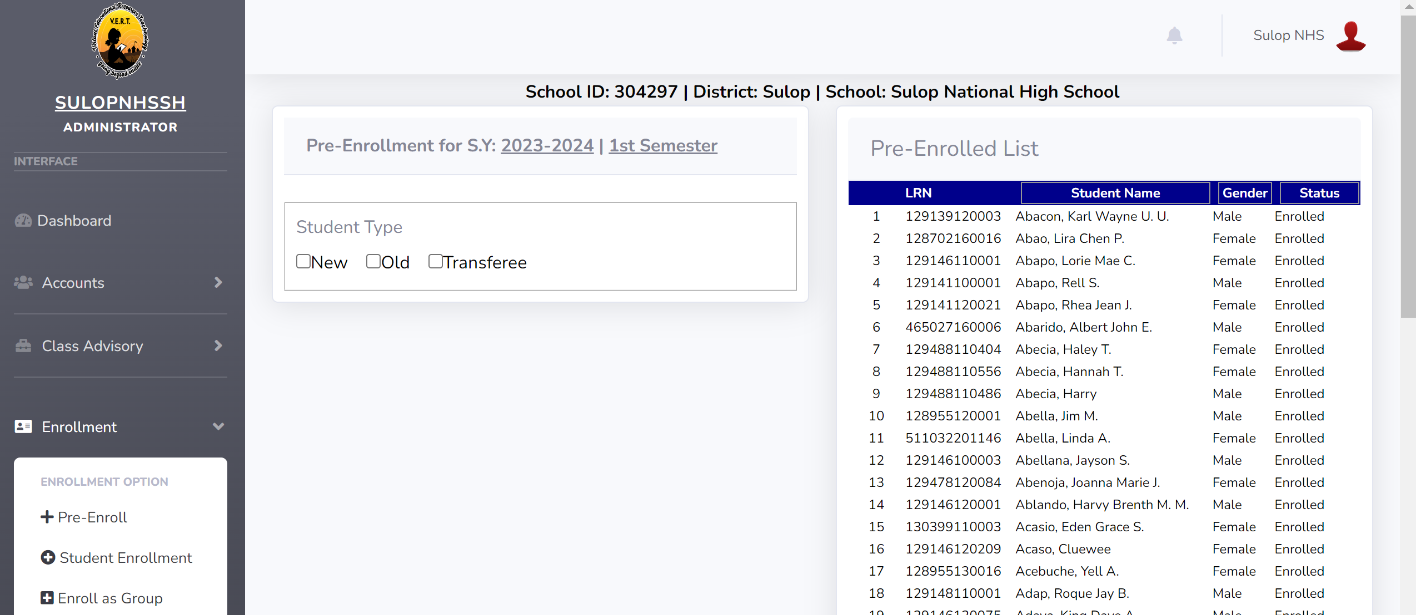
PRE-ENROLL STUDENT
ILMS
ADMIN ACCOUNT
Notes:
Click <Enrollment> select <Pre-Enroll> to pre-enroll possible students of your school; click <New, Old or Transferee> type of student

Slide 11
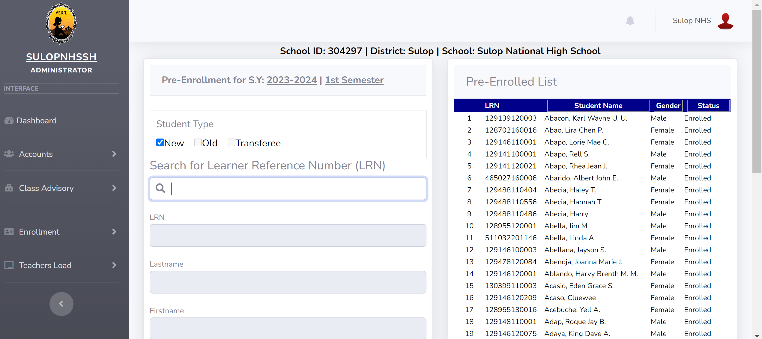
PRE-ENROLL NEW STUDENT
ILMS
ADMIN ACCOUNT
Notes:
Click <Enrollment> select <Pre-Enroll> click <New>to pre-enroll new student (Note: Only registered students in the system can be pre-enrolled)

Slide 12
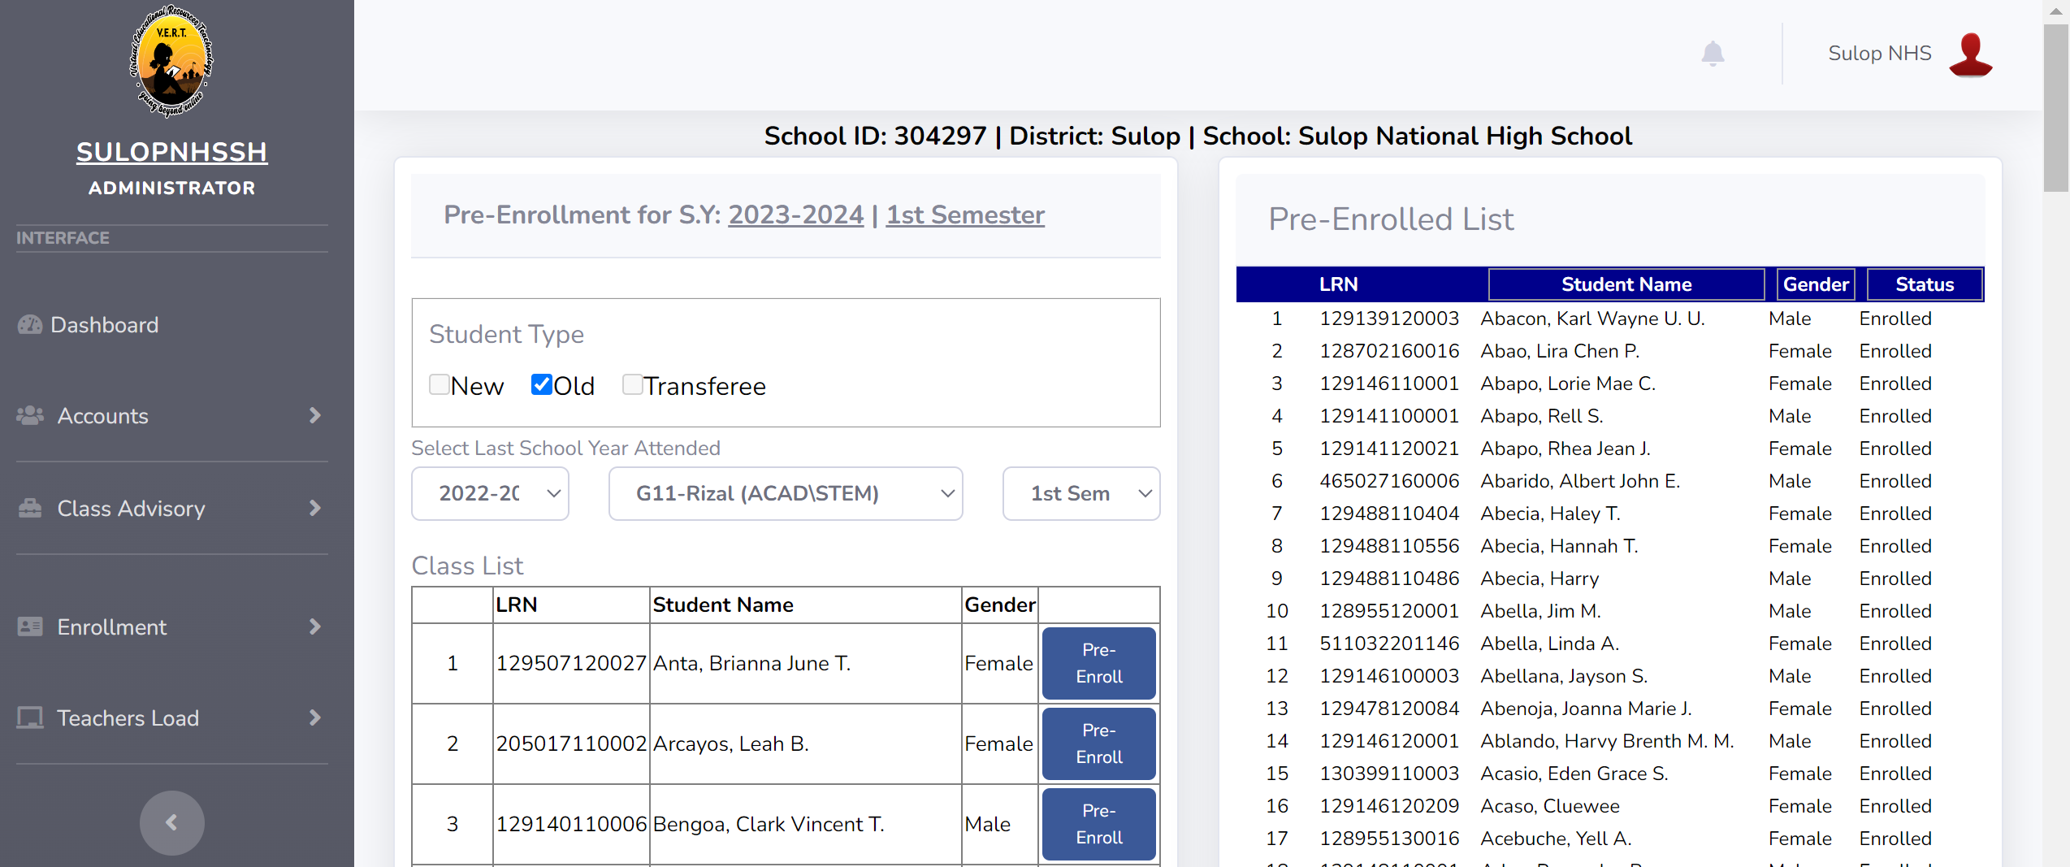
PRE-ENROLL OLD STUDENT
ILMS
ADMIN ACCOUNT
Notes:
Click <Enrollment> select <Pre-Enroll> click <Old>to pre-enroll old student. Select Last School Year Attended, Section and Semester. Click <Pre-Enroll>

Slide 13
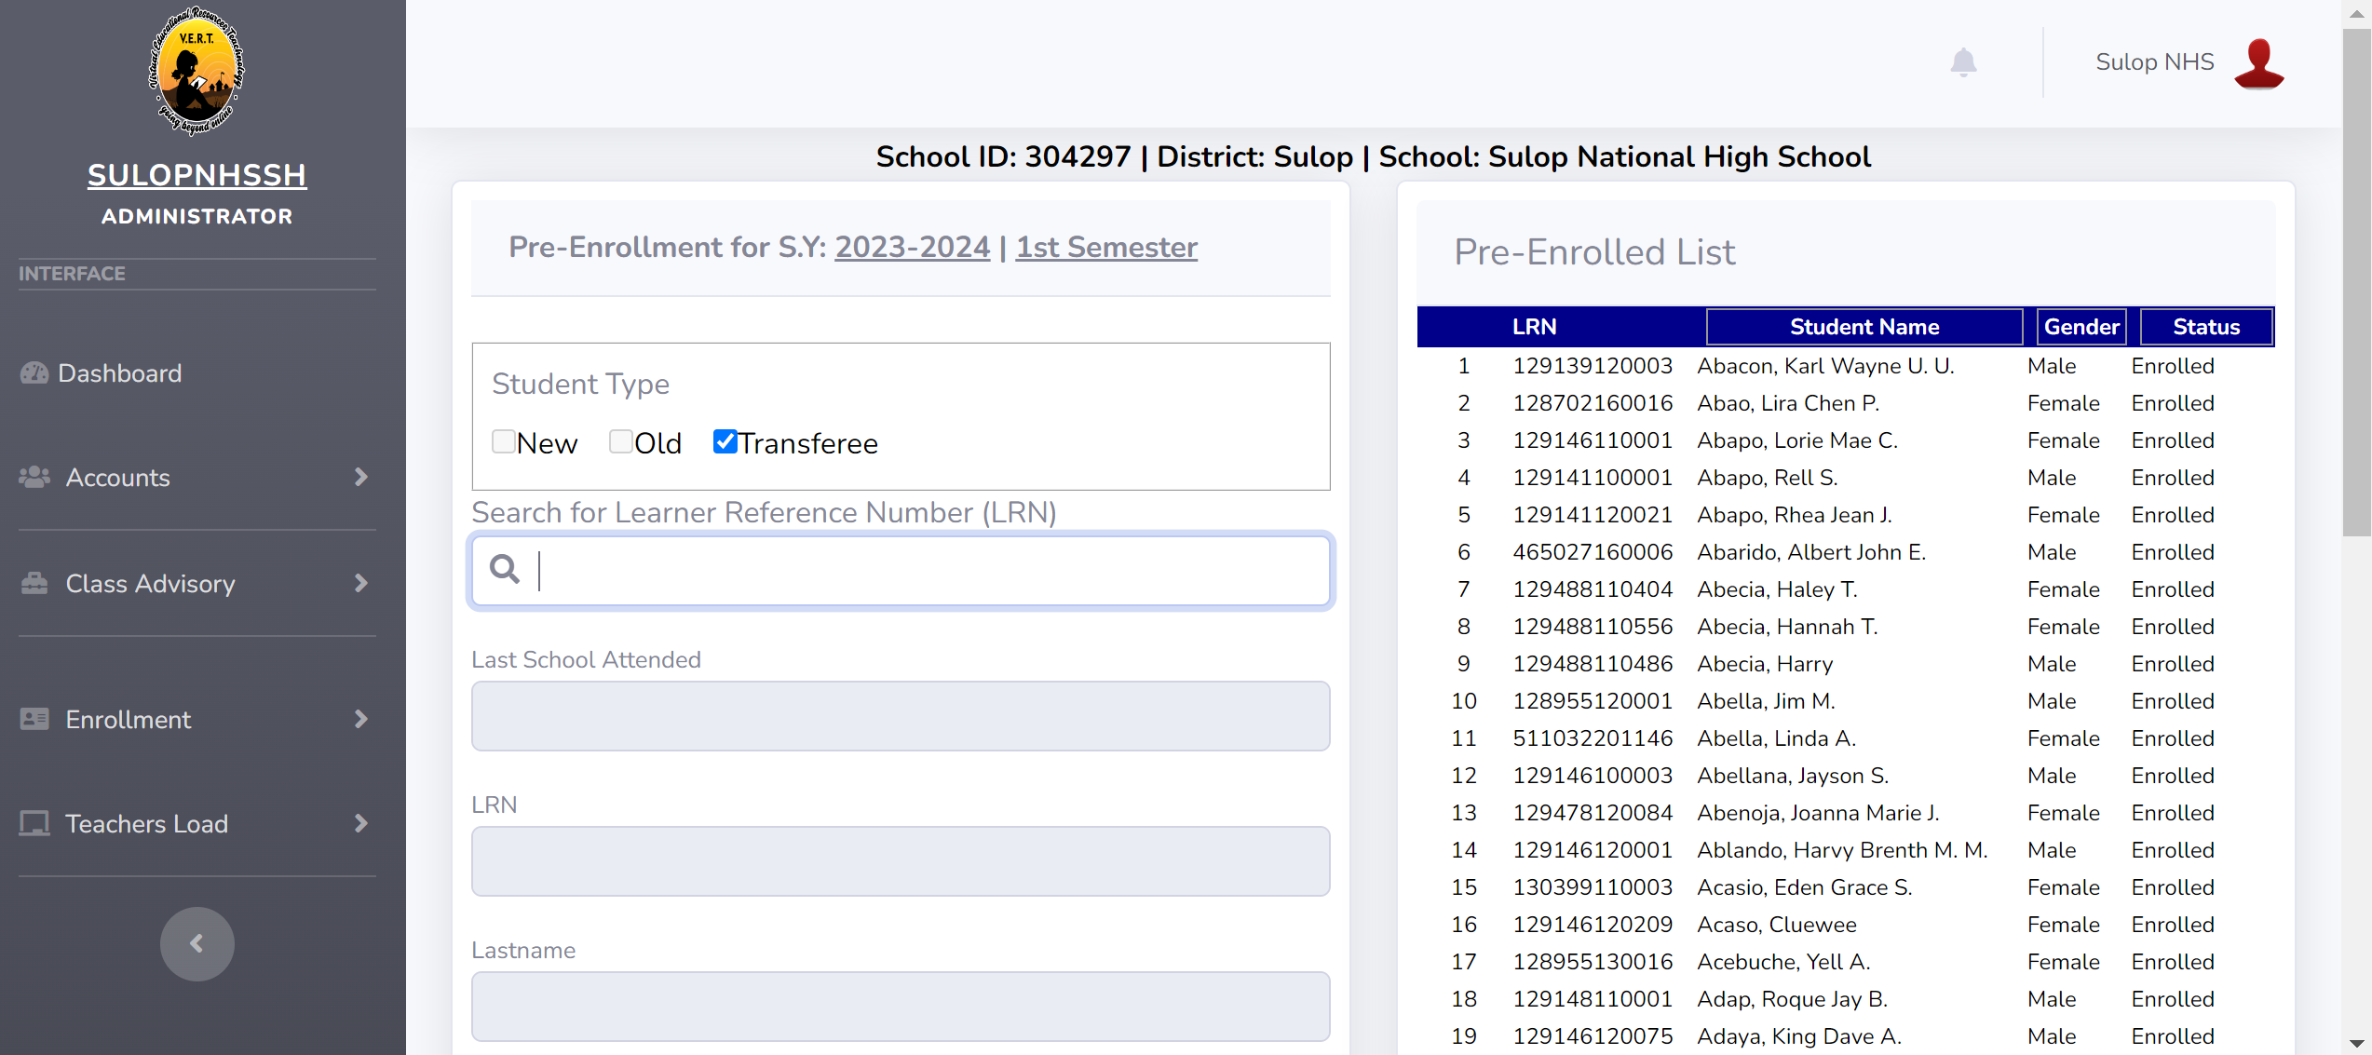
PRE-ENROLL TRANSFEREE STUDENT
ILMS
ADMIN ACCOUNT
Notes:
Click <Enrollment> select <Pre-Enroll> click <Transferee> search student using LRN then click <Pre-Enroll>

Slide 14
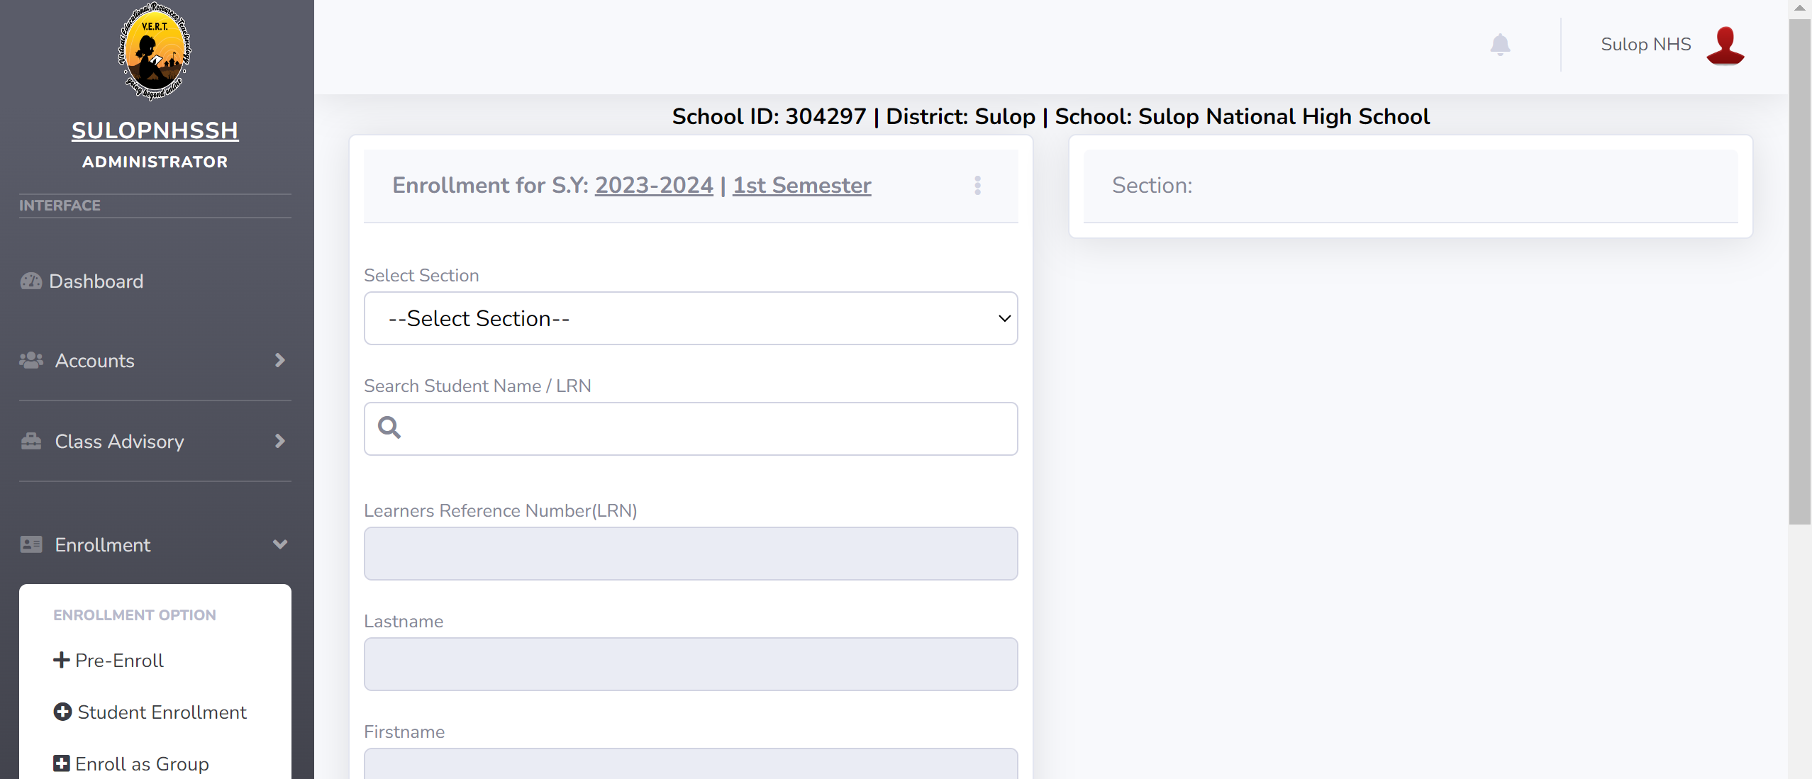
ENROLL/ADD INDIVIDUAL STUDENT PER SECTION/GRADE LEVEL
ILMS
ADMIN ACCOUNT
Notes:
Click <Enrollment> select <Student Enrollment> click <Select Section> search student using LRN then click <Enroll Student>

Slide 15
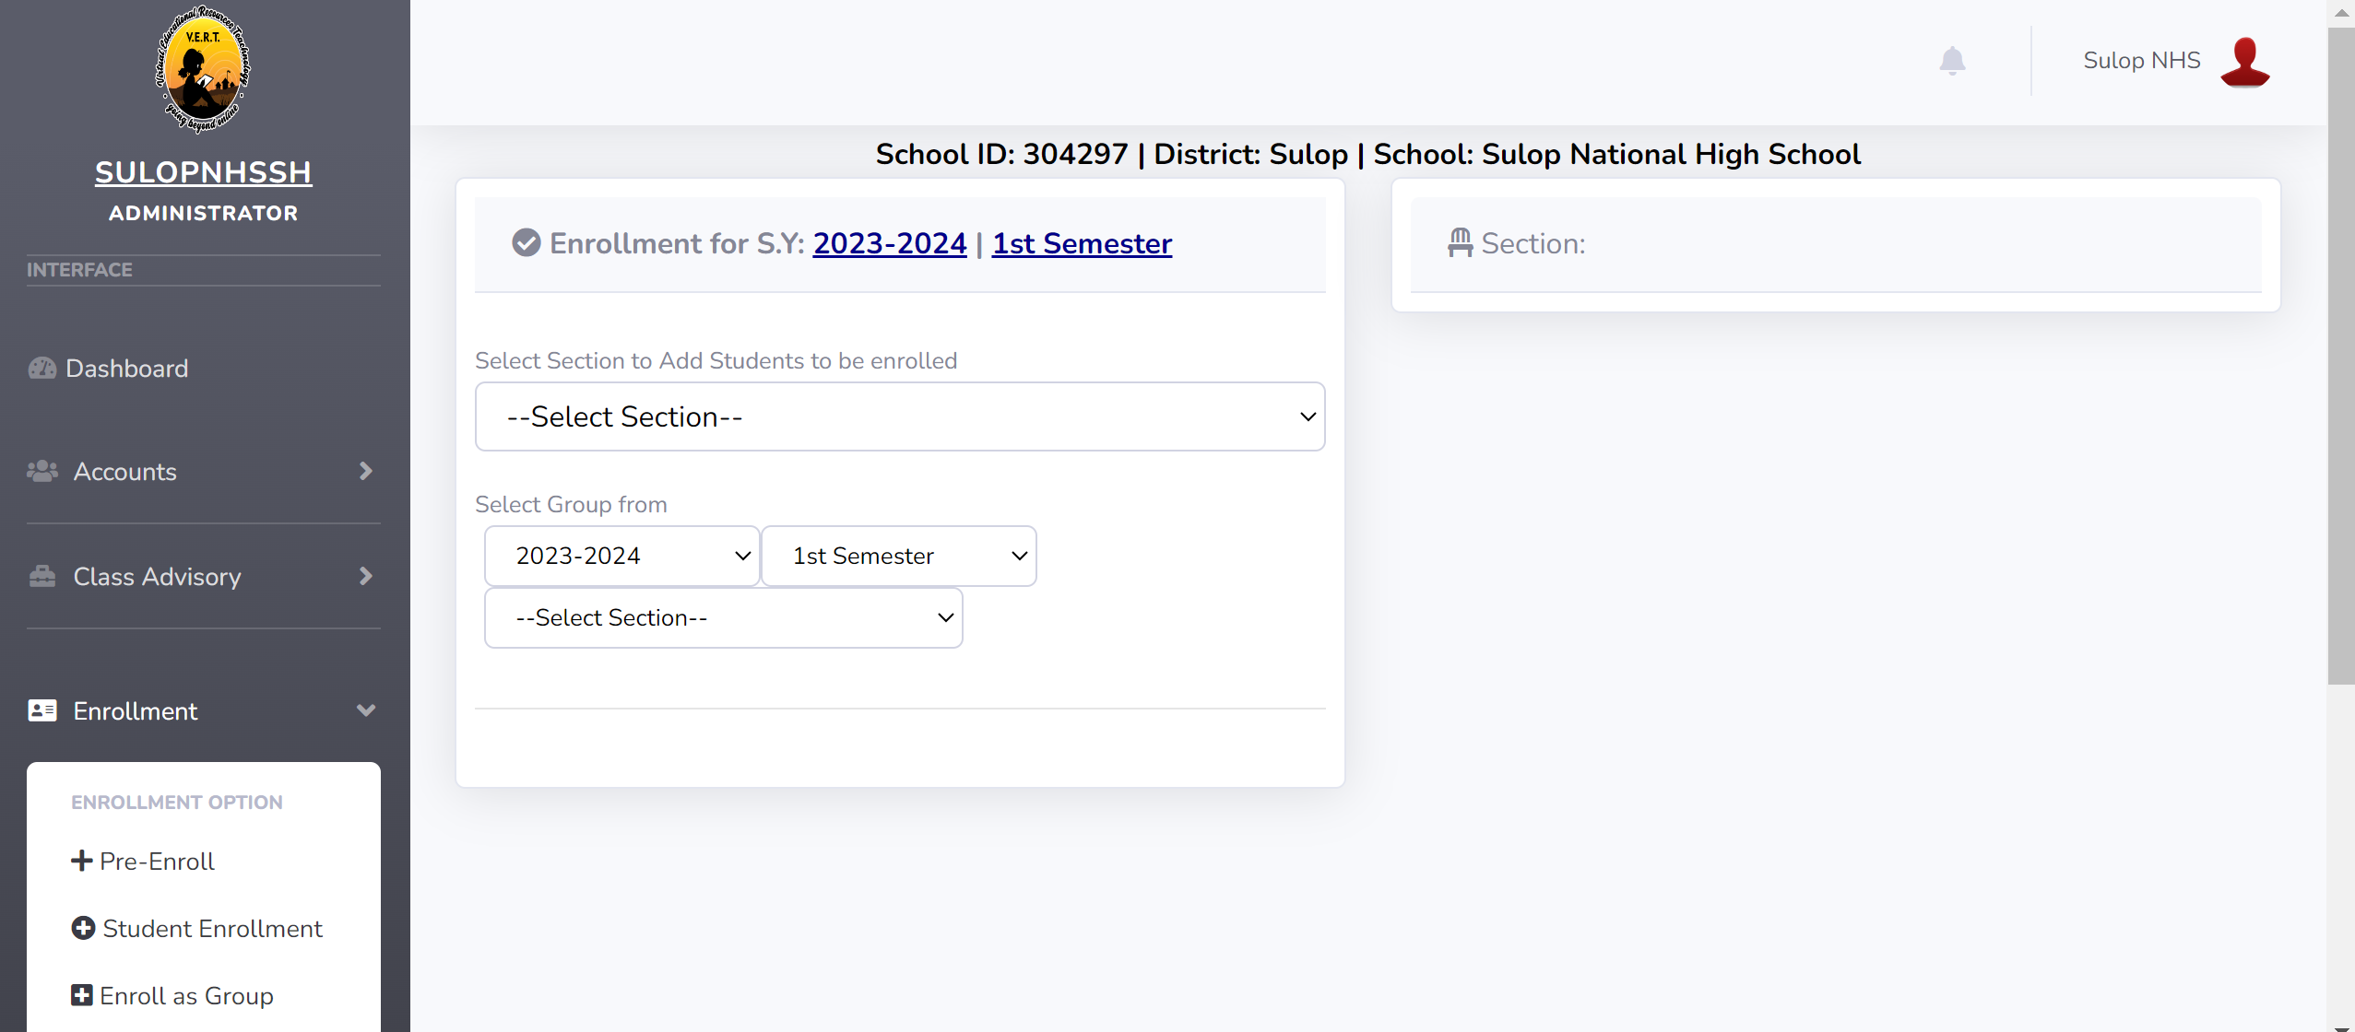
ENROLL GROUP OF STUDENTS PER SECTION/GRADE LEVEL
ILMS
ADMIN ACCOUNT
Notes:
Click <Enrollment> select <Enroll as Group> click <Select Section> where the group of students to be enrolled in the selected section; select (school year, semester, section) where the group of students previously enrolled; click <Enroll as Group>

Slide 16
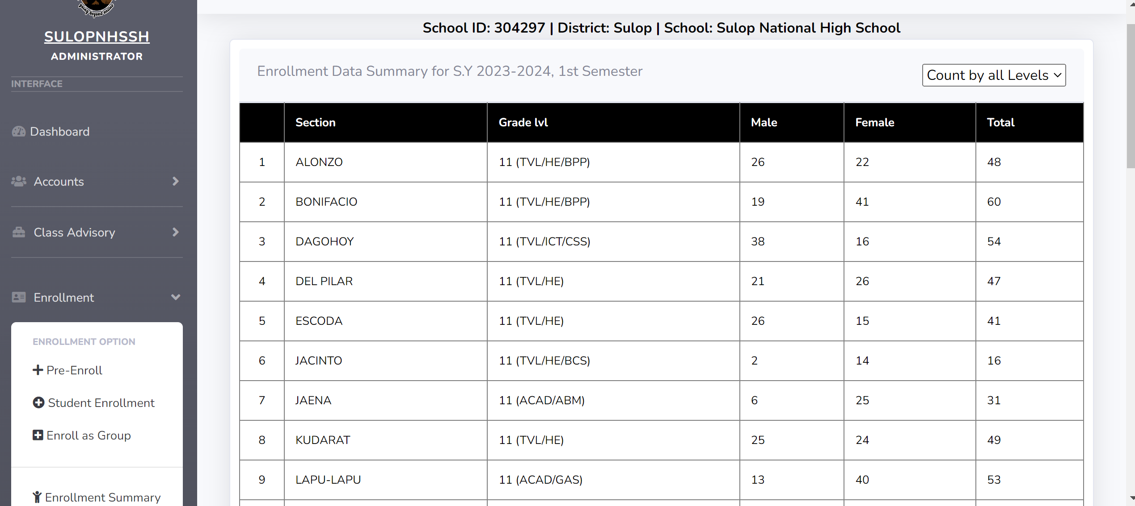
ENROLLMENT SUMMARY
ILMS
ADMIN ACCOUNT
Notes:
Click <Enrollment> select <Enrollment Summary>to view enrollment section enrollment, grade level enrollment and total enrollment.

Slide 17
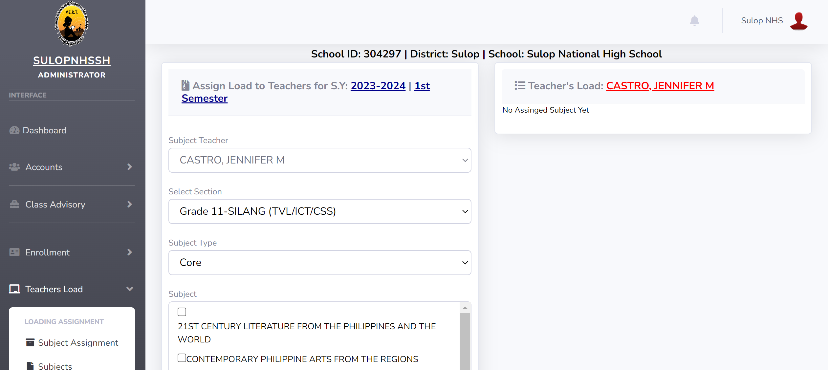
ASSIGNING TEACHER’S LOAD
ILMS
ADMIN ACCOUNT
Notes:
Click <Teacher’s Load> select <Subject Assignment> select <Subject Teacher, Section, Subject(s)> click <Add Load>

Slide 18
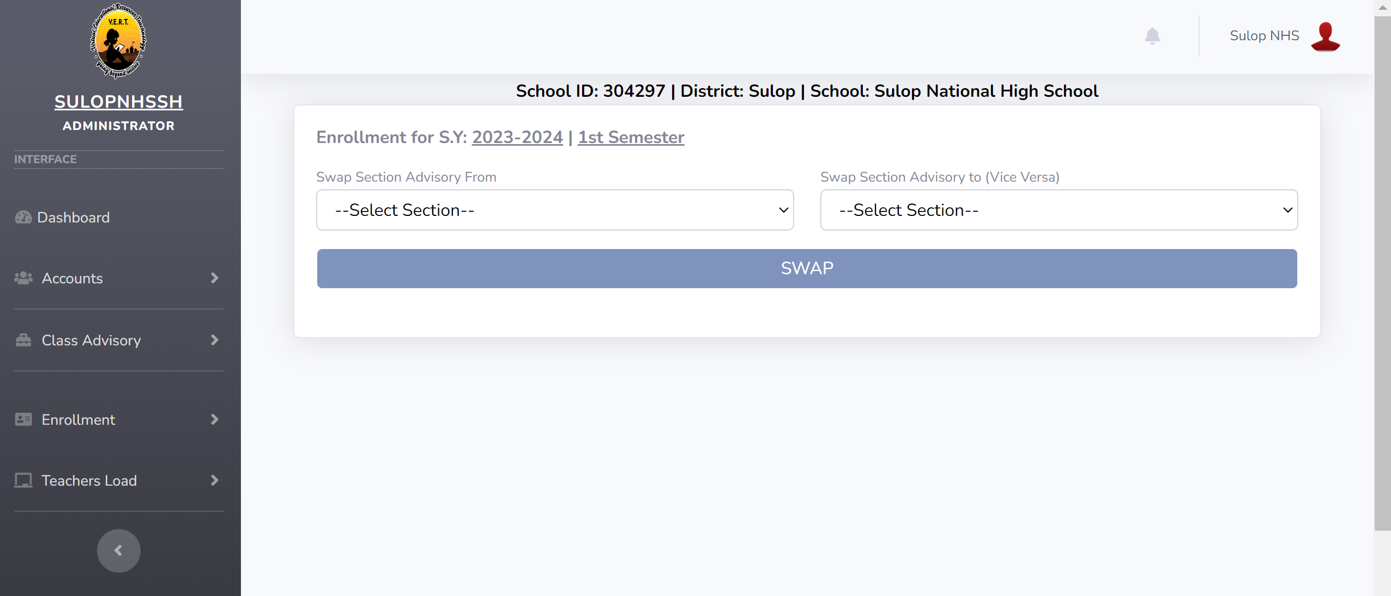
SWAPPING ADVISORY
ILMS
ADMIN ACCOUNT
Notes:
Click <Teacher’s Load> select <Advisory Swapping> select originated <section> then select new assigned <section>

